Slide 1
Mindfulness
A useful resource for reducing stress, increase focus, creativity and productivity in the laboratory
Claudio Colaiacomo
24 October 2019

Slide 2
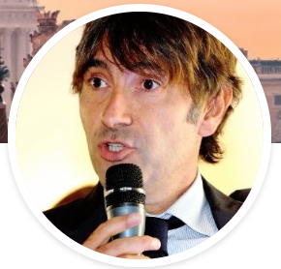
About the speaker
Claudio Colaiacomo
holds a degree and a Masters in Physics an MBA and a Masters in Contemplative Neurosciences from the University of Pisa.
He is a Mindfulness trainer, coach and is part of the Elevier Mindlife initiative which aims to bring mental health resources including Mindfulness to employees.
In his earlier career, he has worked as a researcher in the US and Austria after moving to Elsevier where he covered several managerial roles.
Today he is Vice President for Academic Relations.
Follow Claudio on Twitter: @ClaudioElsevier

Slide 3
What we’re going to leave you with today…
An understanding of What mindfulness is
The benefits it brings
How it relates to our lives as researchers
Appreciation of the science behind
A practice to give you the basics to do this at home and work

Slide 4

This is your Mindful mind

Slide 5

This is your Mindless mind

Slide 6

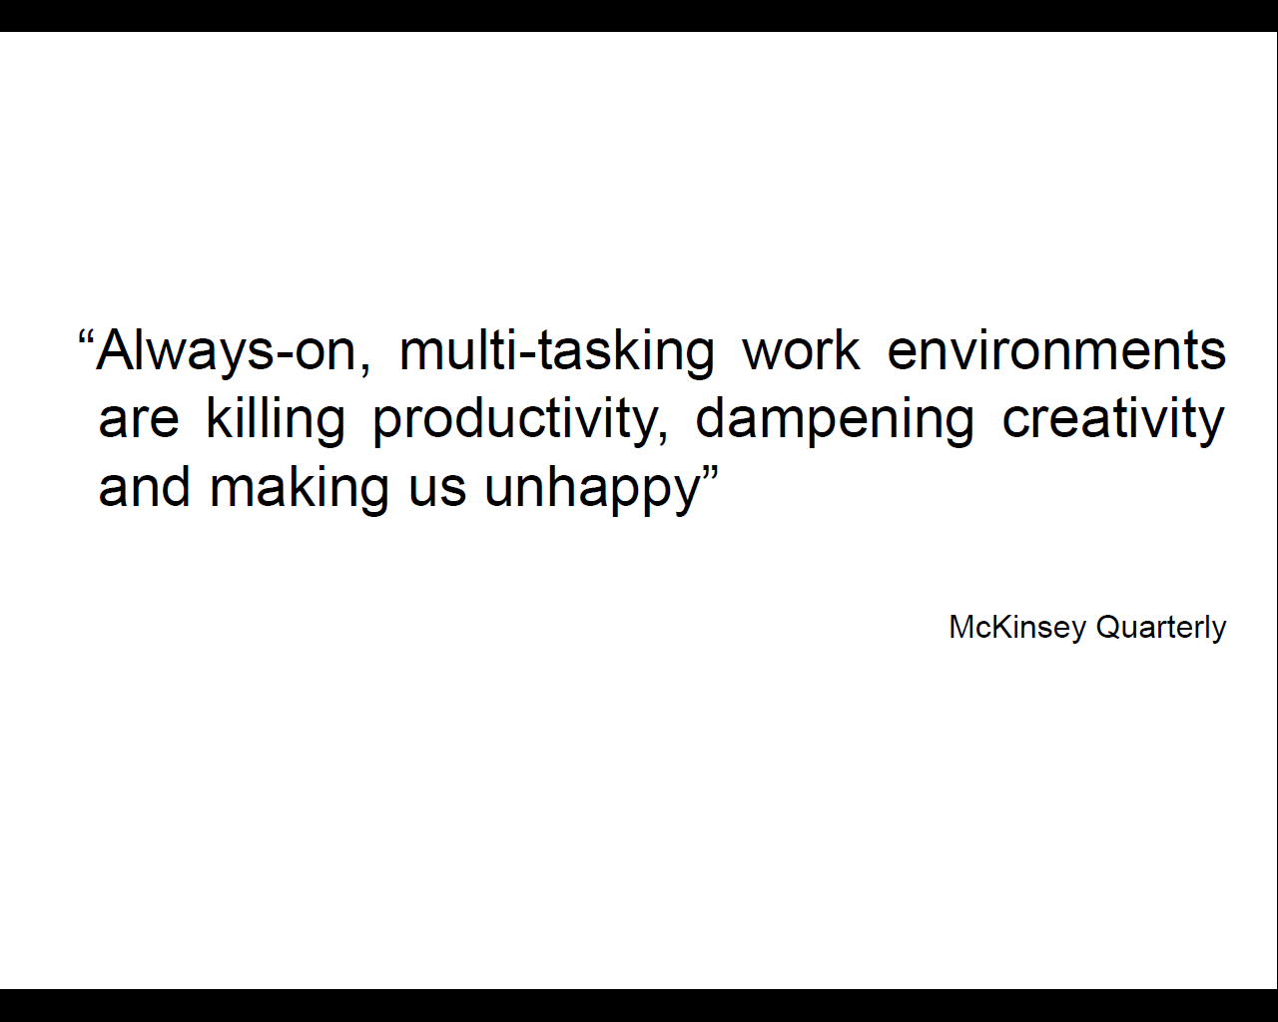
A 2010 Harvard study by Killingsworth & Gilbert on a large sample of polulation, showed almost 50% of the time our mind is NOT present to what we are doing in that moment. That is called «Mind Wandering» and it correlates to reported unhappiness

Slide 7

Hectic life
Add pictire of stressed researcher
Notes:
Describe the always on attitude we have at work, always pressed with time, taking decisions on the go and often in multi tasking distracted more.

Slide 8
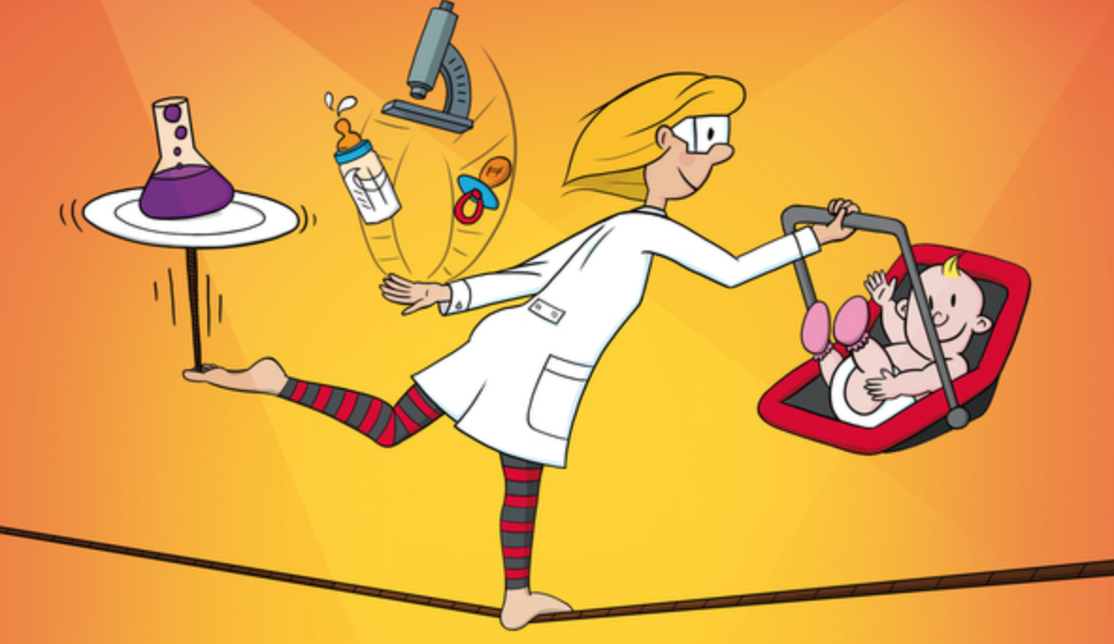


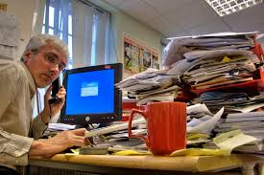

Work Life Balance
Stress Management
Time management
Task management
Team Work
Notes:
Stress is not bad per se but if it gets out of hand it can be dangerous for our health. If we let external events carry us away we seriously risk to feel strond and persisting stress

Slide 9

Mindfulness is training for your mind
Over half a century of research have shown that the brain can be trained to sustain focus and attention in the present moment

Slide 10

Attention to what?
Feelings
Emotions
Thoughts
Moods
Autopilots
Mental Patterns)
Reactions
Rumination

Slide 11

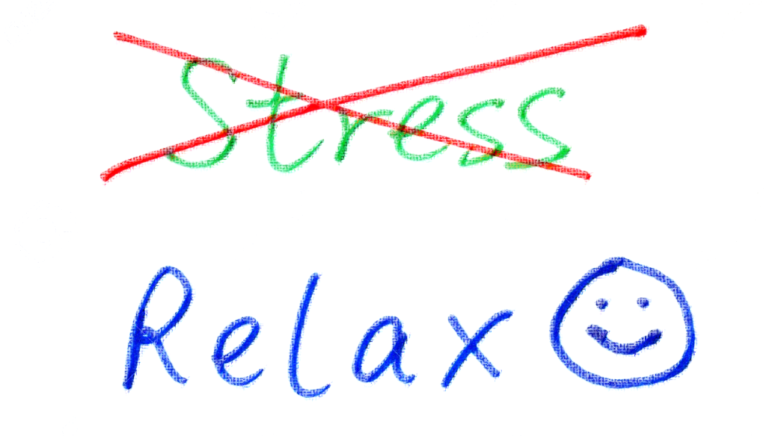
The Benefits of Mindfulness – on our work and lives
Clear thinking
Focus, attention, concentration
Patience
Sleep
Energy
Resilience
Positivity and Balance
Performance and productivity

Slide 12
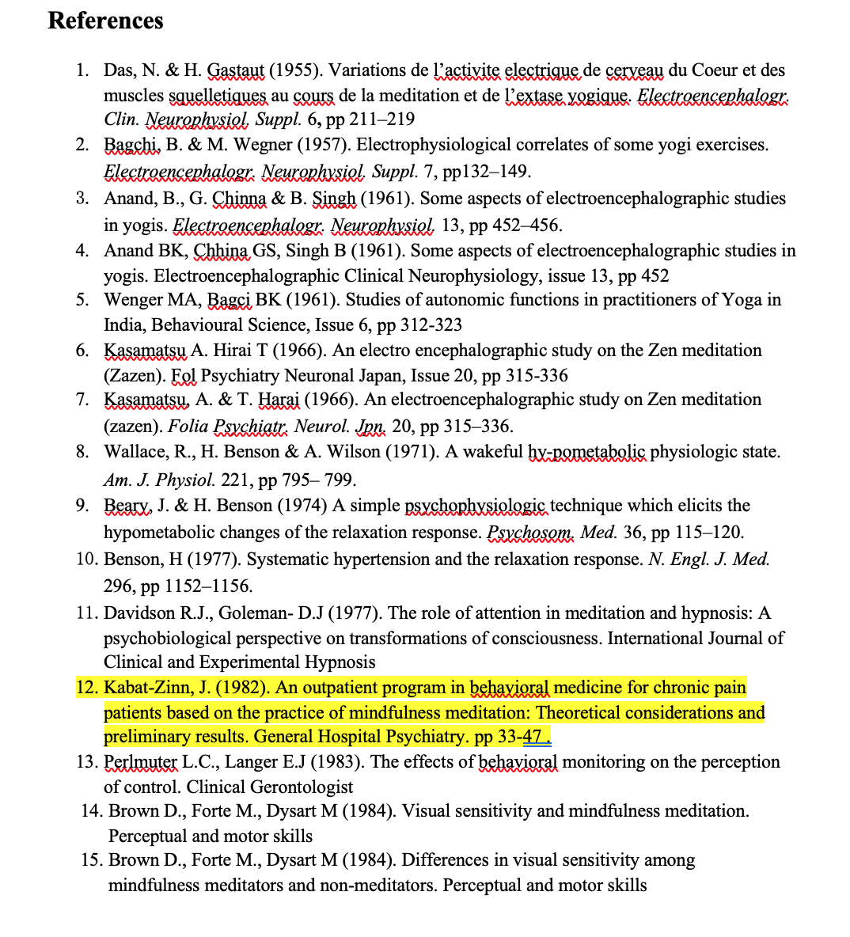
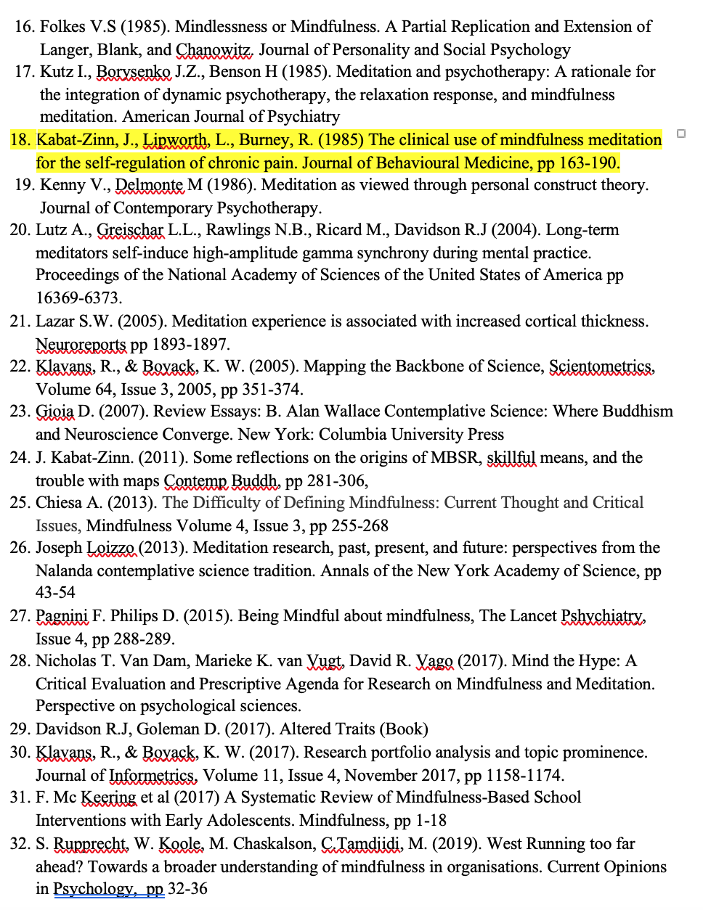
Milestones of research
Notes:
Benefots are NOT only stress reduction but many more. Let’s say stress reductionand increased calm are among the easiest qualities to train.However with disciplined practice many more qualities can be developped

Slide 13
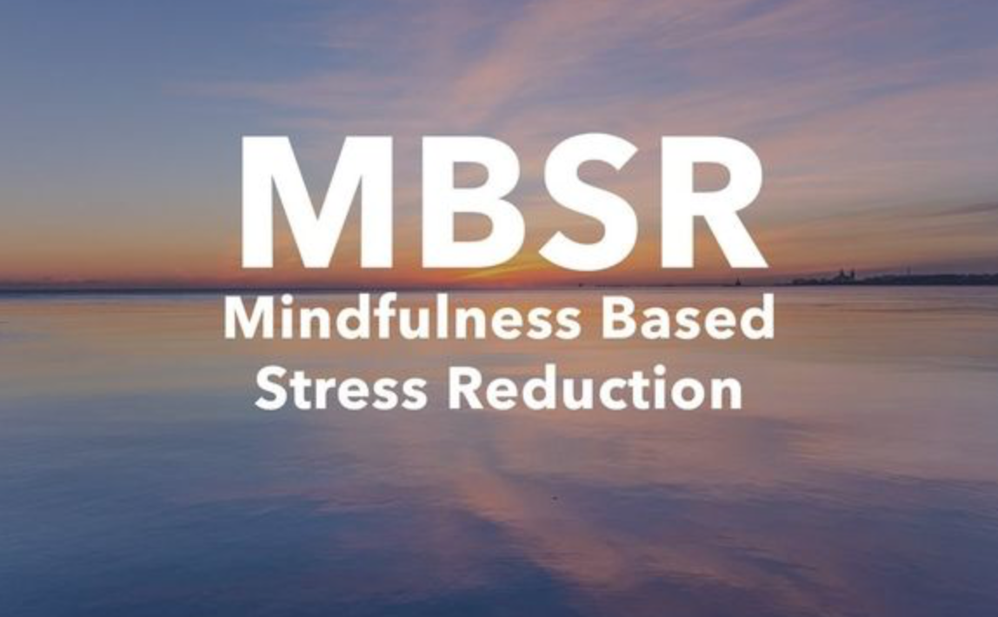
Notes:
Benefots are NOT only stress reduction but many more. Let’s say stress reductionand increased calm are among the easiest qualities to train.However with disciplined practice many more qualities can be developped

Slide 14
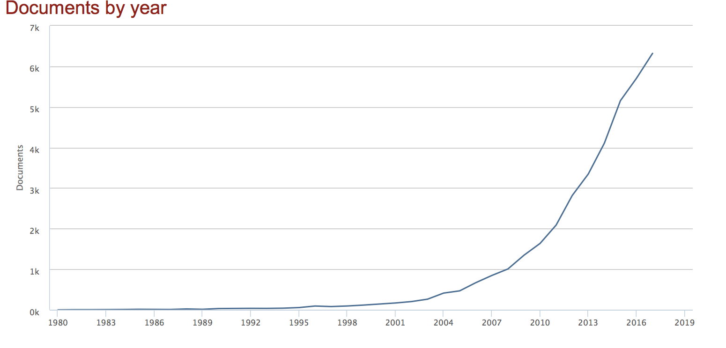
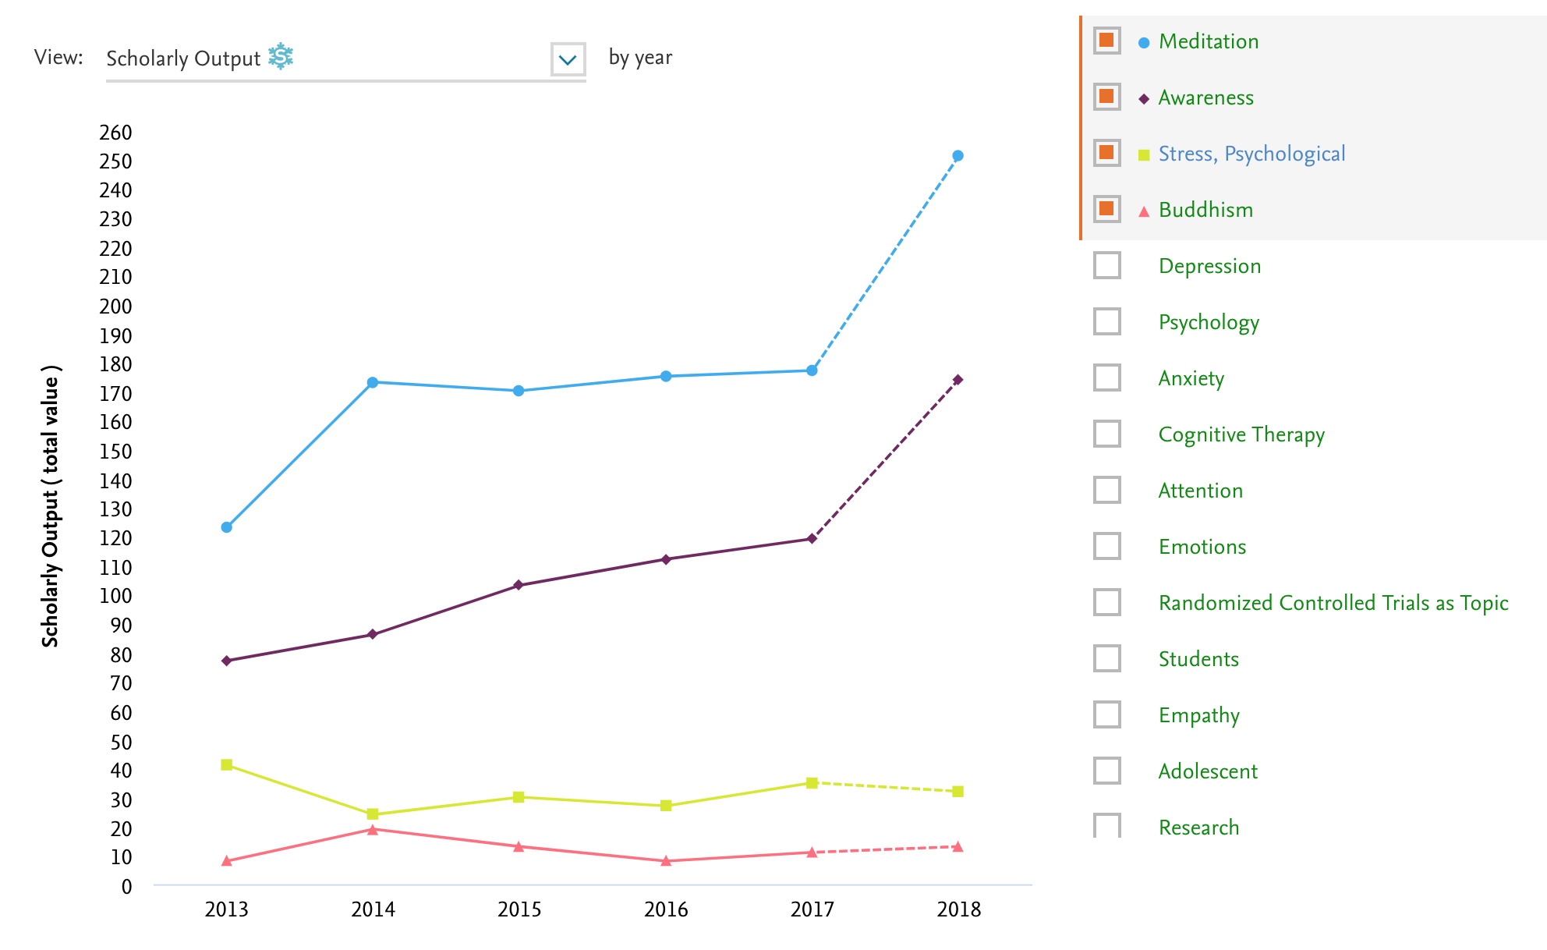
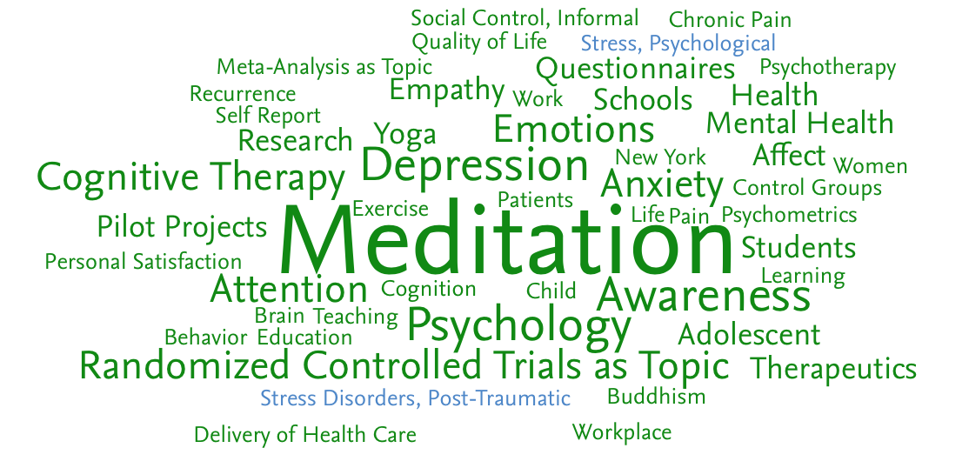
A growing research area
…In many fields
Notes:
Benefots are NOT only stress reduction but many more. Let’s say stress reductionand increased calm are among the easiest qualities to train.However with disciplined practice many more qualities can be developped

Slide 15
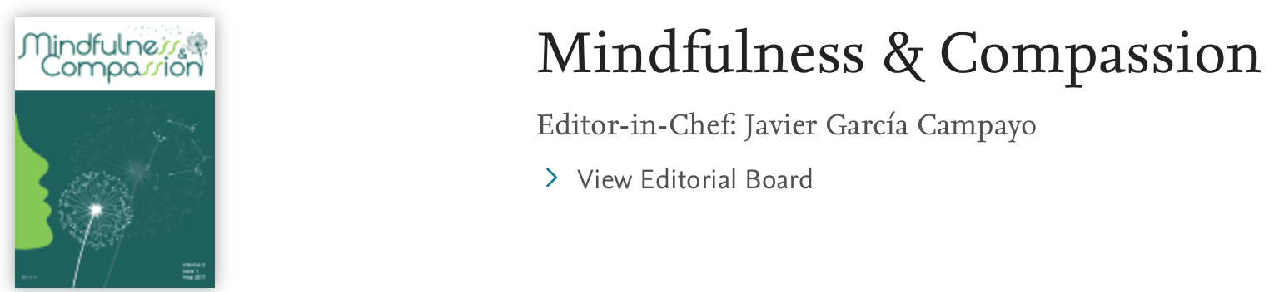
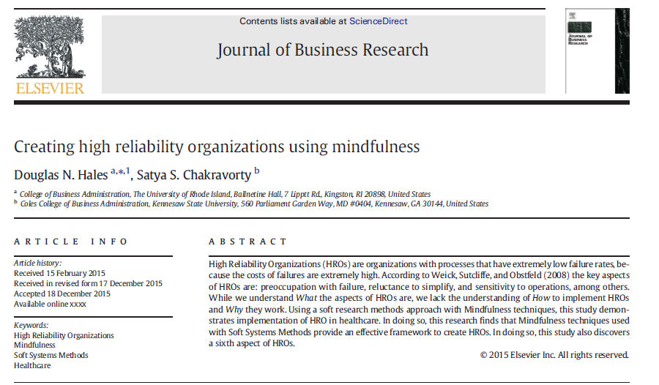
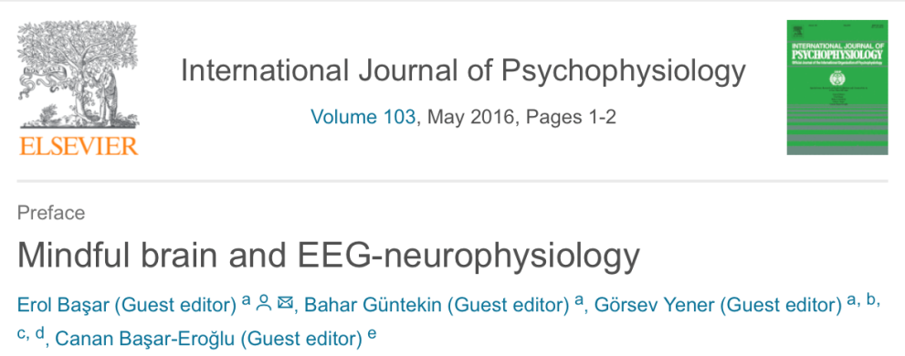
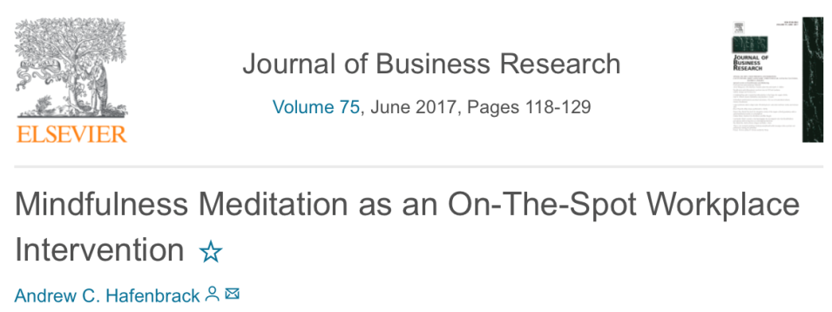
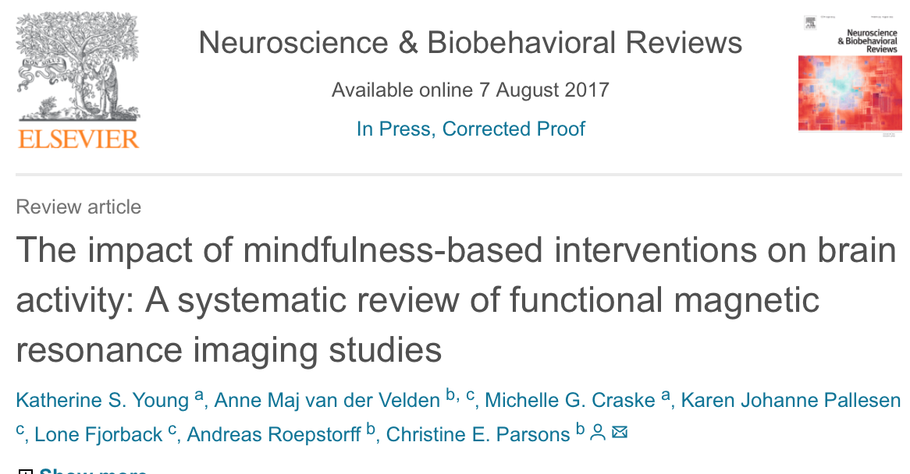
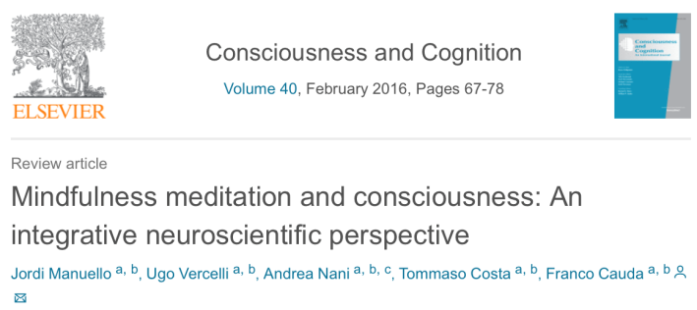
Notes:
Use this slide and next to touch upon the scientific evidence and the adoption by corporations. Mention here Mind Life at Elsevier

Slide 16
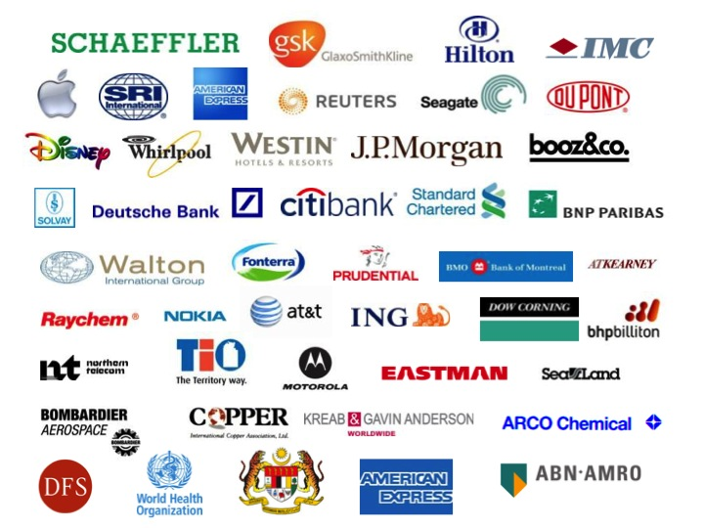
Notes:
Many companies are implementing it

Slide 17
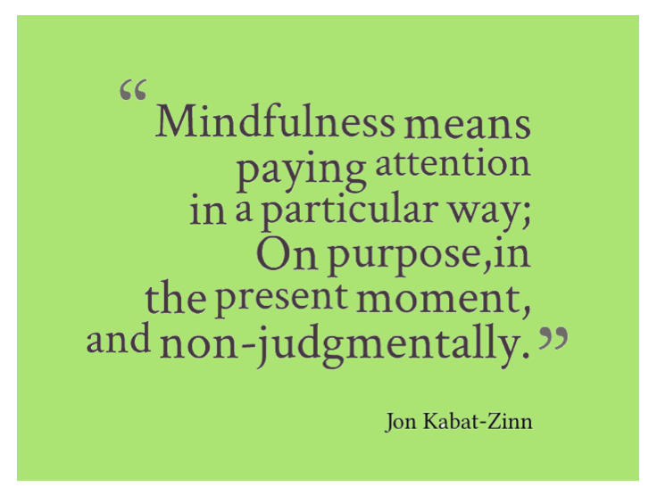

Slide 18
A simpler definition
“Mindfulness is paying attention
every moment to
what’s in our mind
Without getting carried away by it”

Slide 19
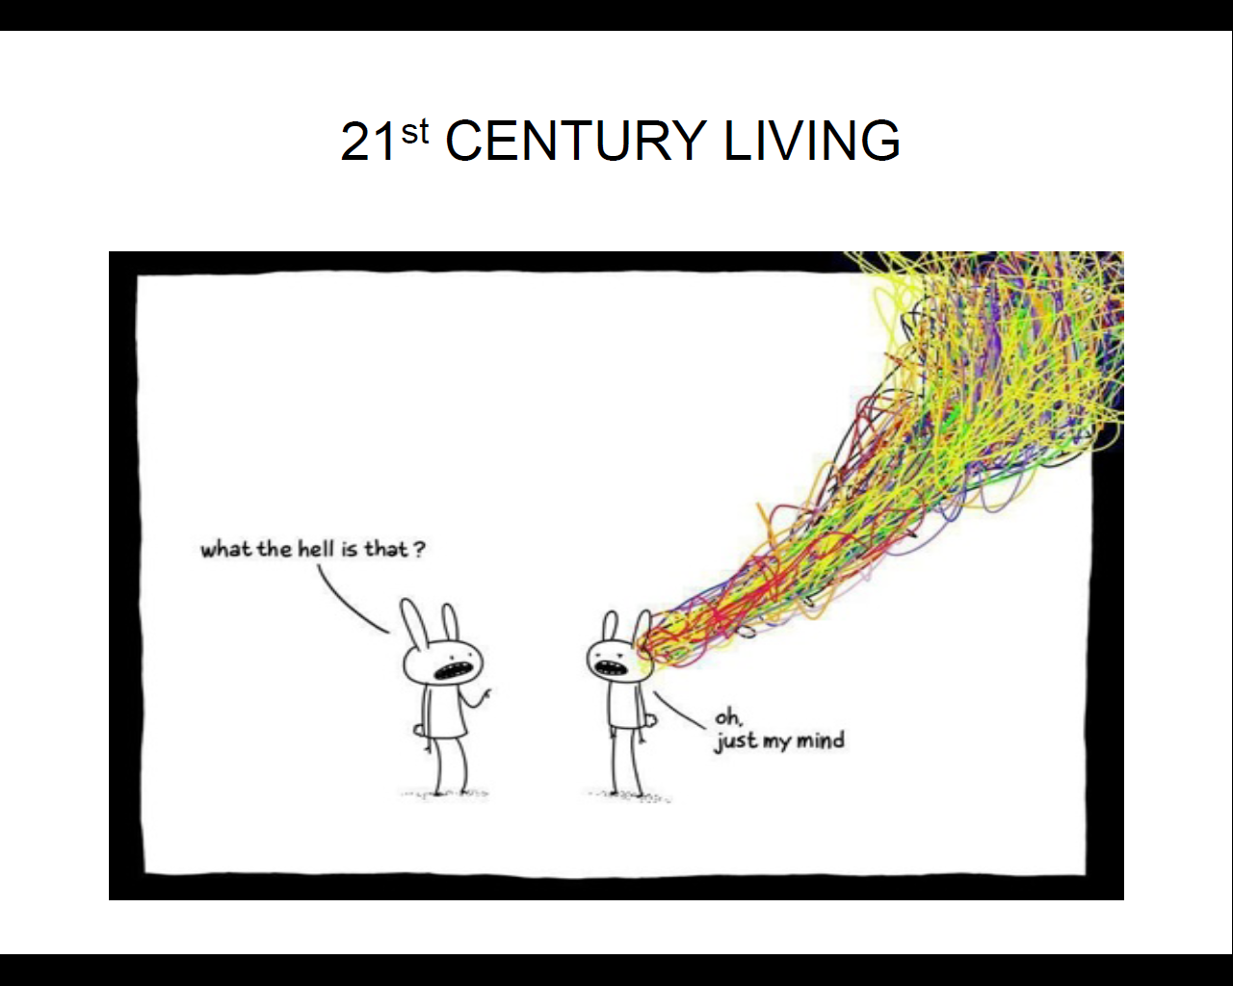

Slide 20
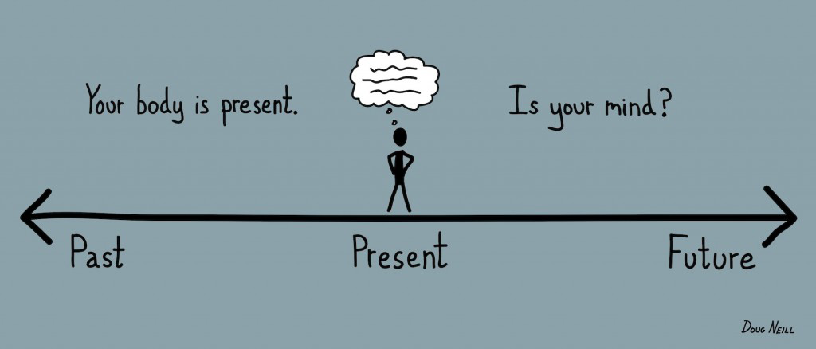
Where is my mind

Slide 21
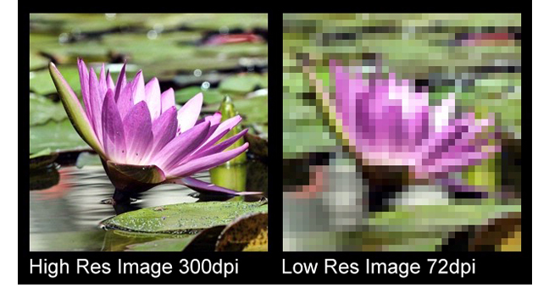
High definition Thoughts

Slide 22
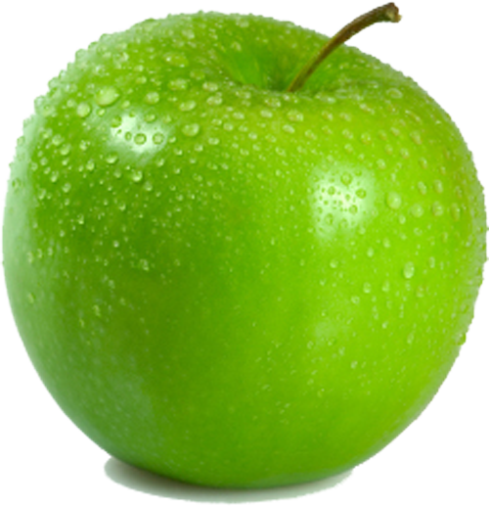
Guided meditation

Slide 23

Stages of the path
Posture
3 deep breaths
Body Scan
Physical sensation of the breath
Focus
Feelings
Object (Breath)
Thoughts
Non judgement
Observing

Slide 24
Further Resources
Books:
Full Catastrophe Living,Using the Wisdom of Your Body and Mind to Face Stress, Pain and Illness By Jon Kabat-Zinn
Headspace, By Andy Puddicombe
Emotional Intelligence 2.0 By Dr Travis Bradberry
Nonviolent Communication, A Language of Life by Marshall Rosenberg
The Mindful Day Practical Ways to Find Focus, Calm, and Joy from Morning to Evening, By Laurie J. Cameron, National Geographic
Meditation is not what you think, Mindfulness and Why It Is So Important
By Jon Kabat-Zinn, Hachette
Be mindfull and stress less, By Gina M. Biegel, Shambhala Publications
Apps:
Headspace
Calm
Insight Timer
Healthy Minds
Short Video: http://my.happify.com/hd/why-mindfulness-is-a-superpower-animation/
Twitter: @ClaudioElsevier

Slide 25
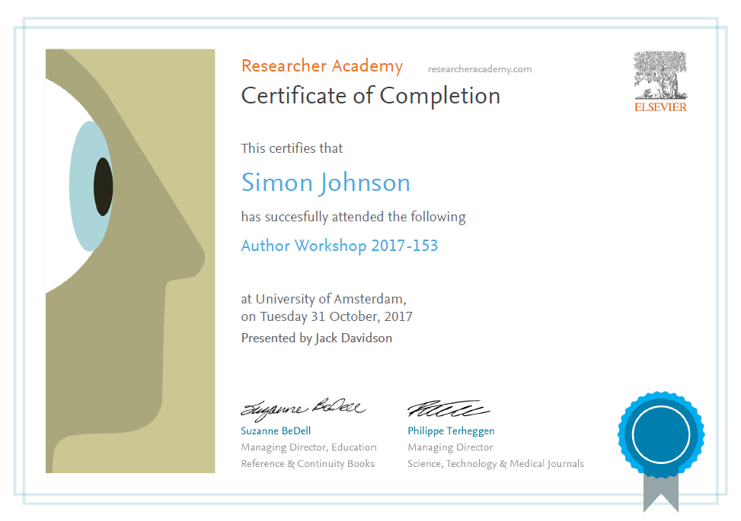
Thank you.
Ask your questions on:
Researcher Academy Mendeley group
Follow us on Twitter

