Slide 1
Section 2: I just got a review invite, what’s next?
Catriona Fennell, Director Publishing Services
May 2019

Slide 2
I just got a review invite, what’s next?
Making the decision
Your availability
Your expertise
Any declarations of interest, for example:
Published with any of the authors in the past?
Work at the same institution as any author?
Personal relationship with any author?
Directly competing with the authors?
Confidentiality

Slide 3
I just got a review invite, what’s next?
If you decide to accept
General instructions & journal-specific requirements
Confidentiality
If you decide to decline
Provide reason
Suggest suitable candidate(s)
Confidentiality
Further reading: Elsevier Reviewer Guidelines: https://www.elsevier.com/reviewers/ Researcher Academy Reviewer Tutorials: https://researcheracademy.elsevier.com/navigating-peer-review/becoming-peer-reviewer
Committee on Publication Ethics Ethical Guidelines https://publicationethics.org/files/Ethical_guidelines_for_peer_reviewers_0.pdf

Slide 4
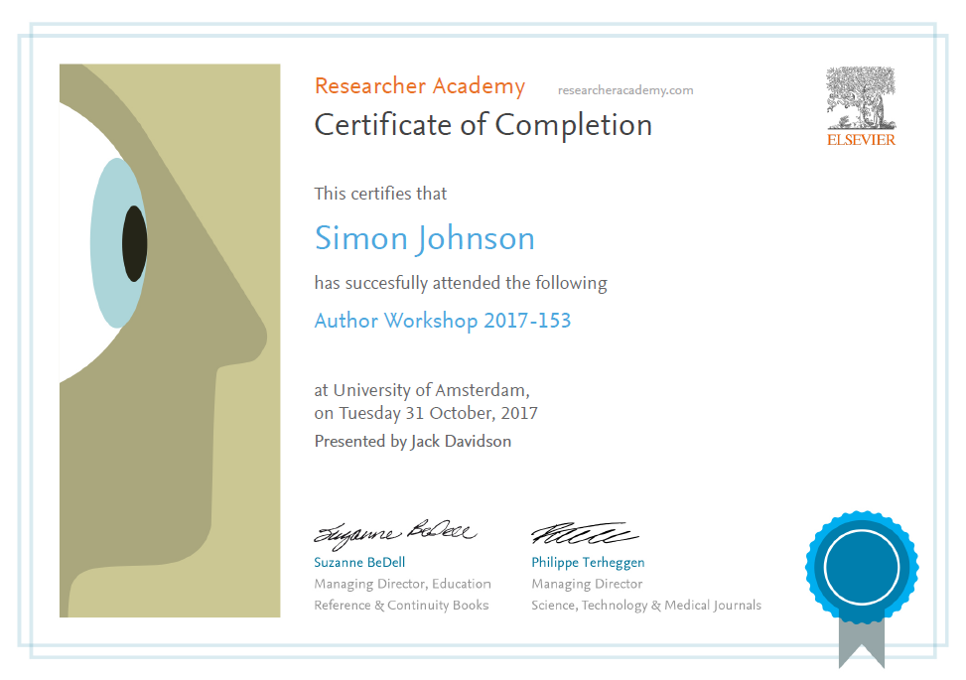
Thank you.
Ask your questions on:
Researcher Academy Mendeley group
Follow us on Twitter

