Slide 1
The typical peer review process
Describing the steps of the peer review process and the role of the author, editor, and reviewer in the process.
Presented by Patricia Gonce Morton
September 2019

Slide 2
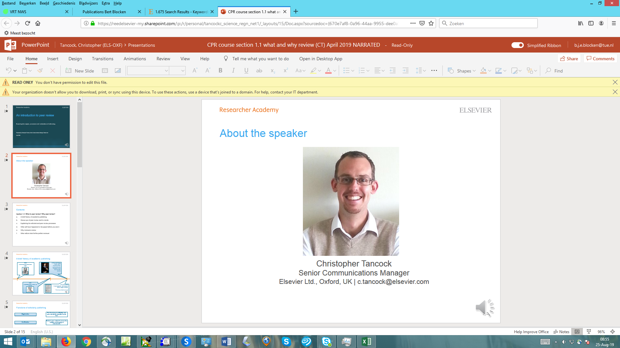

Patricia Gonce Morton, PhD, RN, FAAN
Dean Emeritus, University of Utah College of Nursing
Editor, the Journal of Professional Nursing,
the official journal of the American Association of Colleges of Nursing
Trish.Morton@Utah.edu

Slide 3
Authors submit article to journal
Usually submitted through the journal’s electronic system.
Ideally, the authors have read and followed the author guidelines.
Authors may have sent a letter of query prior to submission.

Slide 4
General impression
Structure/length/readability
Is the manuscript properly structured?
Is the length appropriate?
Are the figures useful and readable?
Is the paper unambiguous and comprehensible, even if the English is not perfect?

Slide 5
Journal editor evaluates the paper
Is the topic in alignment with the purpose and focus of the journal?
If no, the paper is rejected. Many papers are rejected at this stage because the topic is not a good match for the journal.
If yes, the editor may further evaluate for depth and scope of topic, writing quality, logical flow of ideas, novelty of topic.
If deemed acceptable, the editor will select reviewers.
If not, the editor will reject the paper and not send it out for review.

Slide 6
Journal editor evaluates the paper
The editor will determine if the paper is too similar to a recently published paper or one that is in the process of being published.
If too similar If not too similar
reject move to the review process

Slide 7
Journal editor evaluates the paper
The journal may use a plagiarism checking software tool.
Editor must use careful judgement if there is too much similarity of submitted paper with previous published works.
If too much similarity, the paper may be rejected and not sent out for review.

Slide 8
Selecting the reviewer
Many journals aim for two reviewers per paper.
The editor has a database of reviewers and can access a reviewer by topic.
Goal is to select a review with expertise in the topic and/or the method.
Editor attempts to select a reviewer with no conflict of interest such as a reviewer from the same institution as the author.
Reviewer is sent directions and asked to return the review in about two to four weeks on average.
Reviewer is requested to accept or decline the review invitation.

Slide 9
Editor receives reviews
Often reviewers agree to review a paper and produce nothing even when they receive reminders.
If this problem occurs, editor must find another reviewer.
Editors may receive reviews that are of no real help. Reviewer may have only focused on spelling, punctuation, and grammar and offered no real critique of the content of the paper.
If this problem occurs, editor must find another reviewer.
Reviewers often do not return the review in the requested time.
Result is DELAY, DELAY, DELAY !!! And frustrated authors.

Slide 10
Editor assesses the reviews
Editor looks for comments regarding:
Content – accuracy, depth, breadth, currency
Appropriateness of paper for journal’s readers
Quality and clarity of authors’ writing
Organization and flow of ideas
Adequacy of review of the literature
Appropriateness of the method
Use of correct statistics and data displayed in tables or graphs
Conclusions supported by data
Recency of references
Evidence of ethical breaches

Slide 11
Editor assesses the reviews
The editor screens for the tone of the review.
Harsh, unprofessional, condescending comments are not appropriate and may be removed by the editor.
Editor is seeking a constructive tone with comments that are appropriate and useful to an author.

Slide 12
Editor assesses the reviews
Editor makes a decision:
Accept with no revisions (very rarely done.)
Revise - major revisions needed.
Revise – minor revisions needed.
Reject

Slide 13
Editor assesses the reviews
Editor receives the revised version of the paper and may:
Accept the revised version.
Send the revised version back to the original reviewer to see if author addressed concerns.
Not ideal at this stage to send the revised version to a new reviewer.

Slide 14
Summary
Authors submit their paper to the editor via an electronic system.
The editor completes an initial screening and decides to reject the paper or to send it out for review.
The editor selects two or more reviewers with expertise in the topic and/or research method.
Reviewers can positively or negatively impact the progress of the paper based on the time they deliver their reports.
Editor assesses the quality and tone of the review.
Editors make a decision based on their review of the paper and the comments from the reviewers.

