Slide 1
How to manage and publish your research data
Why all researchers should consider sharing their data
Dr. Larisa Yarovaya
David Parsons
23 April 2019

Slide 2
Agenda
Introductions
Why is my data valuable?
Why should I share it?
Where should I store it?
How do I promote it?
Steps to take before publishing
Q & A

Slide 3
About the speakers
Dr. Larisa Yarovaya (PhD, MSc, BA, FHEA)
Deputy Head of the Centre for Digital Finance,
Lecturer in Finance, University of Southampton, Southampton, UK.
Associate Editor:
International Review of Financial Analysis
Journal of International Financial Markets Institutions and Money
International Review of Economics and Finance
Data in Brief
Heliyon

Slide 4
About the speakers
David Parsons
Former Publisher, Data in Brief
Sr. Customer Marketing Manager, Elsevier, North America
MS (in progress) Applied Data Science, Syracuse University
Focus on Data Visualization and Information Policy

Slide 5
Why is my data valuable? What is most valuable?
Examples
Primarily data from scientific experiments (various complexities, confidentiality, and copyright issues; long data collection process; results are linked to know-hows, patents)
Purchased datasets and dataset provided by external parties (Complex and unique datasets that are not publicly available; often very costly to obtain; have some copy right issues from the data provider)
Qualitative data (Hard and time-consuming to collect; harder to extract insights; often textual and unstructured data; have ethical implications, confidentiality issues).
Unique datasets (Data collected based on certain methodology, technique, or set of rules and assumptions that have to be explained and justified; collected from specific set of participants; large in scale and scope; have high replication potential; can be used to address a number of research questions; often time-consuming to collect). Hand-collected data from annual reports; From websites, from annual reports)
Secondary Data collected from multiple publicly available sources (Data has been previously transformed, modified, cleansed, and created dataset is unique in certain way)
Secondary Data (Predominantly quantitative data; accessible data; available for immediate download; can be retrieved quickly from existing databases; doesn’t require any cleansing, formatting, transforming; has no restrictions for sharing and re-use).
C
O
M
P
L
E
X
I
T
Y
V
A
L
U
E
Source: Larisa Yarovaya

Slide 6
Why should I share my data?
Increase impact of the research
Improve quality of the publishable research outputs in our field
Make results trustworthy
Increase citations
Get additional publication (Data-in-Brief)
Improve educational experience and enhance research-led teaching
Increase reputation

Slide 7
Considerations about sharing data
Restrictions from stakeholders
Legal Factors
Data privacy
Project members
Want to publish more papers
Psychological factors
Fear of competition
Costs of data
Incorrect methodology
Poor data quality
Fear of replications
Time and effort invested
Inaccurate and incomplete dataset
Inaccurate results
Inadequate dataset
Source: Larisa Yarovaya

Slide 8
Why is sharing your data becoming so important?
Requirements from research councils and funding bodies
Requirements of academic journals
Large scale research projects
Multidisciplinary research
Increasing speed and ease of collection, storage and analysis of the data
Importance of building professional networks and international reputation
Increased emphasis on impact beyond academia

Slide 9
Where should I store my data?
Choose the right repository
Subject area strengths
Sharing capabilities
Permanent links
Storage limits and timespan
Reputation in community
Allows for versioning
Visualizer within
If in doubt, ask your librarian or PI!
Many resources available online

Slide 10
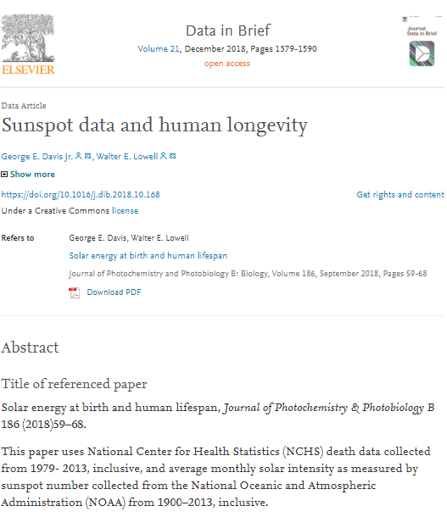
How do I promote and validate my data?
Consider publishing a Data in Brief paper
Open access, peer-reviewed descriptions of datasets
Research across all fields welcomed
ESCI and Scopus Indexed, DOI assigned
Two ways to submit
Direct submission, or
Co-submission with original research paper
Data can be either attached to article, or hosted within an open repository
elsevier.com/locate/dib

Slide 11
What to consider now?
Develop detailed Data Management Plan prior conducting the research;
Think carefully about future data sharing and re-use;
Carefully select project partner (businesses, authorities, international research institutions) and consider their data sharing policies and practices;
Sort out all agreements and get permissions in advance;
Purchasing data? Think about the Return on Investments;
Want to re-use data before making it available for replication? Plan time, work on several papers simultaneously, invite more co-authors to help you;
Carefully collect and organise your data, ensure accuracy at every stage of the process, keep record of all data transformation and modifications.

Slide 12
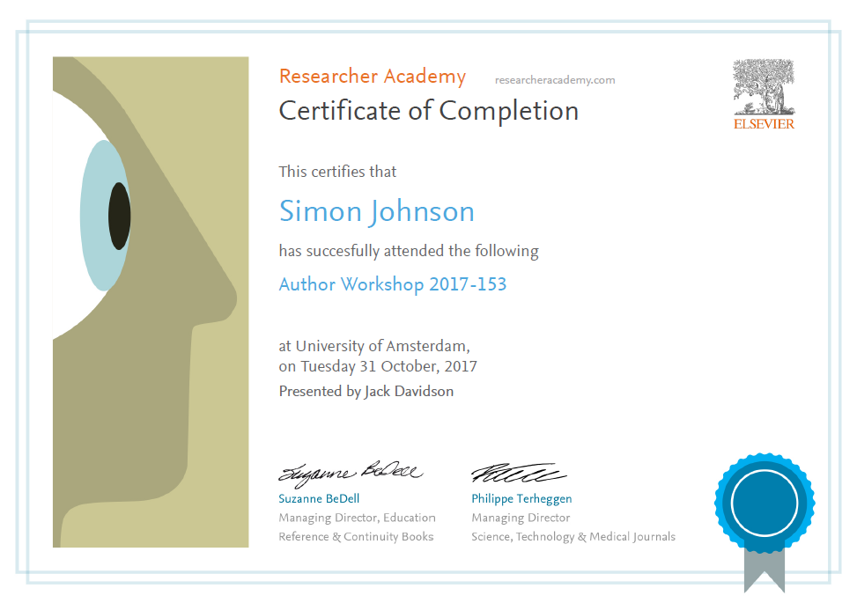
Thank you.
Ask your questions on:
Researcher Academy Mendeley group
Follow us on Twitter: @ResearcherAcad

