Slide 1
How to write a case report
… a brief guide for writing case reports
Prof. Oliver Kurzai, M.D., Editor in Chief Medical Mycology Case Reports
Prof. Adilia Warris, M.D., Editor Medical Mycology Case Reports
28 February 2019

Slide 2


About the speakers
Oliver Kurzai, M.D.
University of Würzburg, Germany
Editor in Chief, Medical Mycology Case Reports
Chair for Medical Microbiology and Mycology, Specialist recognition for Microbiology, Virology and Infection Epidemiology.
Adilia Warris, M.D.
University of Aberdeen, Scotland
Editor, Medical Mycology Case Reports
Paediatric infectious diseases specialist, Co-director of the MRC Centre for Medical Mycology, Chair of the European Paediatric Mycology Network (EPMyN).

Slide 3
Case Report
Description of an individual clinical case
Detailed outline of symptoms, diagnosis, treatment decisions, outcome
Discuss related cases / differential diagnosis / treatment options

Slide 4
Which case should I publish?
In past, journals often asked for unique features, first descriptions of new entities or significant contribution to medical knowledge, some journals still do…
Nowadays: specialized case reports journals (like MMCR) with focus on the educational value of a case.
Can other MDs learn something important from your case? – If so: Write it up!

Slide 5
What makes a case-report interesting for publication?
A unique case with either……
  an unusual, rare, perplexing presentation,
  identification of a causative fungus not being reported before
  a remarkable finding during the diagnostic work-up
  the use of a new treatment modality
  a surprising follow-up and/or outcome
  unexpected complications
  therapeutic challenges or dilemmas
    ……which is of interest and relevant for the rest of the medical (mycology) world with respect to lifelong learning aimed at improving recognition and management of consecutive patients.

Slide 6
The very first steps
Discuss with your medical team
Background research
  Extensive literature search needed
  ‘me too’ cases are not of interest
Getting permission and consent
Information gathering
  Documentation of clinical presentation (signs & symptoms) and along the disease course
  Clear results from diagnostic tests, including identification of fungus and susceptibility pattern
  Detailed overview of treatment given and response
  Formulate up to 3 bullet point messages on what you want to communicate

Slide 7
Tell a story
Chronological order of events
  She came in very ill......., we were afraid for……., therefore we tested if she had….., the test was positive…….., we changed our management approach…….., but unfortunately……., we had to amend……..
Differential diagnostic considerations
  Tell the reader the reasons for performing specific diagnostic tests
Clinical decision making process
  Support for conditions considered
  Support for additional investigations
  Clear interpretation of diagnostic test results
Follow-up
  End of story can range from ‘Full Recovery’ to ‘Death’

Slide 8
How to prepare a case report
MMCR style:
Define a day 0 (e.g. day of hospital admission, first symptoms, etc.)
Give all other important dates in relation to this:
    Sample taken on day 1
    Lab result reported on day 3
    Treatment initiated on day 4 / ceased on day 9
    History of travel abroad day-28 to -21
    …
Consider a graphical representation of the events on a time-line for complex cases

Slide 9
Get the details right
Describe the activating signs and symptoms which have resulted in the differential diagnosis.
  both positive and negative signs and symptoms
Describe actual values for blood test results if relevant for the next step in the decision making process
  differentiate, not each test result need to be presented
Detail dosing of medications prescribed
  variable to take into account with respect to outcome and complications

Slide 10
What about figures?
We all like pictures!
Pictures tell you more than a thousand words!
But it needs to have a function!
  macroscopic and microscopic images if a new causative microorganism is identified
  radiological images if activating sign in the diagnostic and therapeutic management of the patient
  photographs of the patient (anonymized) when mucocutaneous disease, skin rashes, dysmorphologies, visible abnormalities during physical exam (e.g. severe inguinal lymphadenopathy; a red and swollen joint)

Slide 11
Attract attention
Title
  Concise
  Informative
  Relevant
  Attractive!

Slide 12
Attractive titles
  ‘Two cases of Emergomyces pasteurianus infection in immunocompromised patients in the Netherlands’
  versus
  ‘First two cases of Emergomyces pasteurianus infection diagnosed in the Netherlands’
  ‘Treatment of cerebral mucormycosis with drug therapy alone: a case report’
  versus
  ‘Successful outcome of cerebral mucormycosis with drug therapy alone’

Slide 13
Introduction
DO
Set the scene
DON’T
Don’t provide an extensive overview of each aspect of the disease your patient is suffering from
  the reader will get bored before the actual part starts of

Slide 14
Discussion
DO
Start with the main points why this case report is of importance
Summarize the aspects to be discussed
Stay focussed
DON’T
Don’t summarize the case report as such
Don’t provide an extensive overview of all aspects of the disease your patient is suffering from

Slide 15
What else do I need to consider?
A case report is a detailed description of an individual patients clinical course – due to its very nature it will likely almost always contain information that could be traced back to the patient!
Consent:
Inform patient that the case will be published.
Discuss potential images, especially if they show the patient.
Ask for written consent.

Slide 16
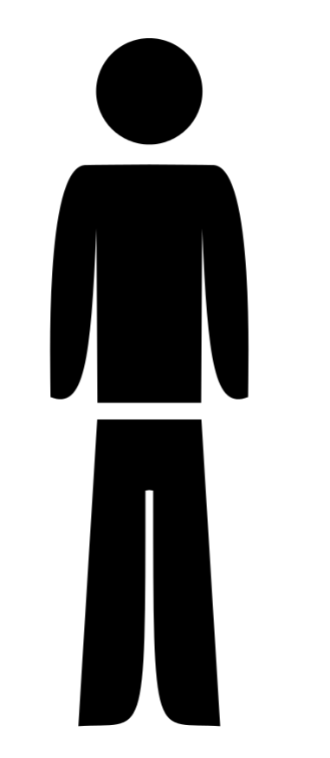
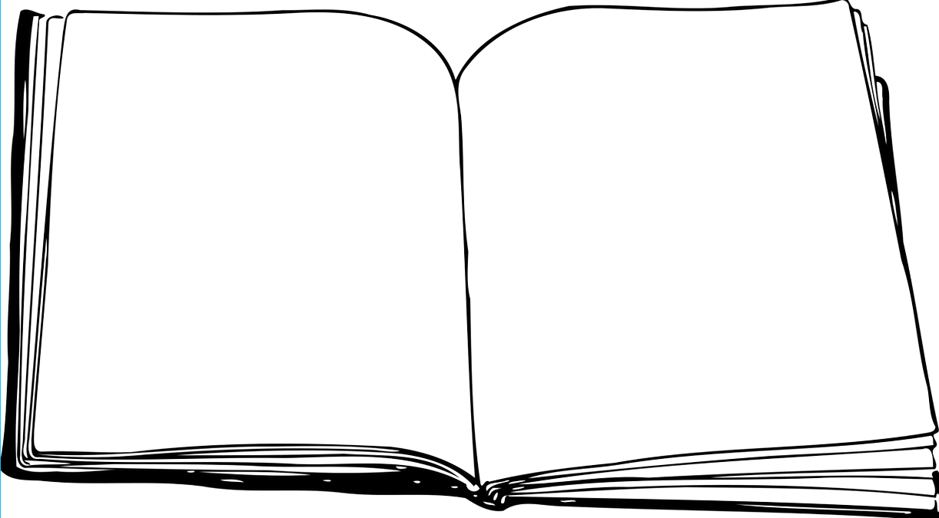
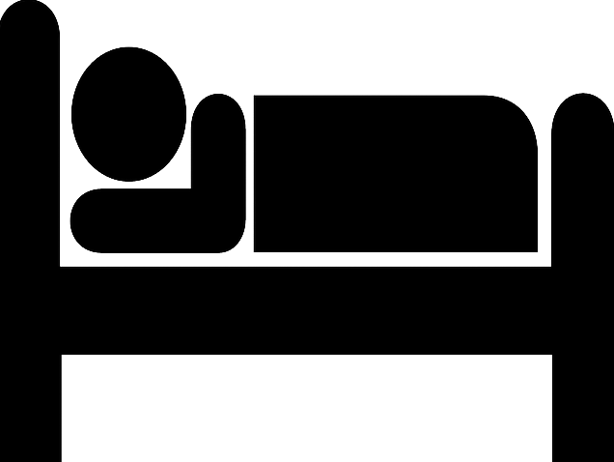
Do I need informed consent of the patient?
confirms that informed
consent has been given
asks for
informed
consent
My favourite
Case Report Journal
gives
Do not reveal patient identity to the journal (e.g. by submitting the IC form with name and signature of the patient)
Special circumstances:
Patient deceased (relatives), pediatric (parents)
Patient unavailable
Institutional general consent required from all patients (upon admission to hospital)

Slide 17
Any case were I can publish without informed consent?
Important public health message
Impossible to obtain informed consent despite all efforts
Benefit of publication outweighs potential harm
(Kleinert and Wagner, Committee on Publication Ethics 2012)

Slide 18
Which journal should I select?
Clinical Medicine Journals
Case Report Journals
Open Access
High reputation, Impact Factor
Case Reports „unwanted“, high chances of rejection
Often relatively long review processes
Specialized in publishing case reports, no „default rejection“
Build case repositories easily accessible for readers (search functions)
Often faster review process (e.g. MMCR ~2 weeks to first decision)
No impact factor, reduced visibility of individual report

Slide 19
Relevant Literature
Green BN, Johnson CD. How to write a case report for publication. J Chiropr Med 2006
Rison RA. A guide to writing case reports for the Journal of Medical Case Reports and BioMed Central Research Notes. J Med Case Reports 2013
Stokes V, Fertleman C. Writing a case report in 10 steps. British Med J 2015; 350: h2693
Sun Z. Tips for writing a case report for the novice author. J Med Radiat Sci. 2013 Sep; 60(3): 108–113.

Slide 20

Thank you.
Ask your questions on:
Researcher Academy Mendeley group
Follow us on Twitter

