Slide 1
Planning Your Research Career Journey
Job Search Strategies for Early Career Researchers
Natalie Lundsteen, The University of Texas Southwestern Medical Center
25 July 2018

Slide 2
About the speaker
20+ years working in research institutions as a faculty member and advisor to students, postdoctoral researchers, and alumni
Global experience at Stanford University, University of Oxford, Massachusetts Institute of Technology, The University of Texas
My career path gradually shifted to where I exclusively provide advising and support for graduate students and postdocs
Current focus population: biomedical science PhDs
Co-authored ReSearch: A Career Guide for Scientists (Elsevier, 2017)
My own research interests are in the development of professional expertise. I am curious about how individuals become successful in their workplace, and how they choose those workplaces

Slide 3
What we will cover today
Career planning as an ongoing process
Things to consider during your job search
Developing your job search methods, including communication and networking skills

Slide 4
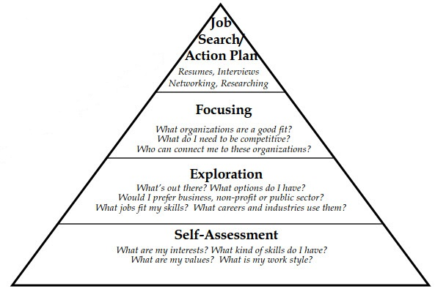
The career development process
Most people think it starts at the top but it really starts here!
Credit: Peter Fiske

Slide 5
Job search strategy: things to consider
Understand self and personal factors
Understand viable occupations and organizations
Be thoughtful, undertake research on both self and workforce
Don’t leap before you look

Slide 6
Typical career search questions researchers ask:
How do I get a job in ________?
Can you get me a job in ________?
How do I write a CV?
What career paths fit my research expertise?
Who’s hiring?

Slide 7
Better questions to ask:
What do I enjoy doing?
What am I good at doing?
What are various career paths really like?
What career paths and organizations are the best fit for my skills and interests?
Do I even know my own skills and interests?
Where would I be most happy at work?

Slide 8
Why are these questions better?
Researchers are often set on matching domain expertise to a career and ignore other important career choice factors
Researchers lack exposure to fields beyond their own discipline and the academic research environment
Career thinking for researchers is difficult
Lack of established pathways
Fear/anger about years of research work ‘for nothing’
Fear/lack of knowledge about different environments
Steep learning curve, but luckily researchers are very good at learning and research!

Slide 9
Planning the career journey
Understand that your career search will be both quantitative (understanding your career options) and qualitative (determining careers where you will best fit)
Assess all aspects of potential career paths and know your own preferences before preparing to apply
Understand the importance of putting together both self-knowledge *and* career path knowledge

Slide 10
What’s next in your career?
Do I need a job NOW, or do I have time to look?
Do I want academia? Maybe? Do I have a backup plan?
What options are possible for my individual situation?
Will visa status impact my search?
Does anyone else have a stake in my career decision-making?

Slide 11
First consideration: types of research jobs
First, think about how research fits in to your career plan
Next, consider your personal career (and personal) goals
More on this later!
Begin exploring career path options
VersatilePhD
Biocareers (for life scientists)
My IDP (Science careers)
ImaginePhD (for humanities and social scientists)
Professional associations
LinkedIn or other alumni databases
Google/other search engines (not the best tool but worth a try)

Slide 12
What ’search parameters’ exist for you?
Do you have a target market?
Are there sufficient job opportunities in your target market?
How about a geographical preference?
Timing constraints?
What size organization is right for you?
Have you considered working environment, workplace atmosphere, and organizational culture?
What kind of people do you enjoy working with?
Which of these parameters is non-negotiable (if any)?
What resources do you need to be able to answer these questions?

Slide 13
Second consideration: Personal Assessment
Four major components to career self-assessment
Skills
Interests
Personal characteristics
Values

Slide 14
Skills (i.e. ‘What am I good at doing?’)
Skills describe your ability to perform a task
They are portable (such as: analyzing, managing)
Don’t confuse skills with experience
Experience is usually expressed as a descriptor/label attached to a specific job, such as Director or Supervisor
Experience is not always portable; context matters
Assess your skills using MyIDP or ImaginePhD

Slide 15
What skills do employers seek?
Ability to work in a team structure
Ability to communicate verbally (both internally and externally)
Ability to make decisions and solve problems
Ability to obtain and process information
Ability to plan, organize, and prioritize work
Ability to analyze quantitative data
Technical knowledge related to job
Proficiency with computer software programs
Ability to communicate in written form
Ability to influence others

Slide 16
Interests (i.e. ‘What do I enjoy doing?’)
What subject areas fascinate and absorb your attention?
What careers have you considered throughout your life?
What would you do if you knew you would NOT fail?
Assess your interests using MyIDP, ImaginePhD, or keeping a list over time

Slide 17
Personal characteristics (i.e. ’What makes you unique?’)
Your personal traits enhance your ability to perform certain tasks successfully in the workplace
How would you describe yourself?
How would others describe you?
What are your strongest characteristics?
Assess traits in conversation with family, friends and colleagues, or by using Gallup StrengthsFinder

Slide 18
Values (i.e. ‘What is important to me?’)
Values give our lives meaning and purpose
Values are often sources of workplace conflict
Changing life circumstances may affect our values
Many people value careers based on economic reward (it’s okay!)
Assessing your values is a personal process

Slide 19
Put it all together and get started
Try and have your top 3 skills, interests, personal traits and values in mind as you begin your career search
Before embarking on a career journey, consider:
What is going on in your life? What is the catalyst for action? Are you mentally prepared?
If considering a career change/pivot, be sure to understand all that is needed to make such a major move
Do you have the capacity (time, resources) for undertaking this career search?

Slide 20
Establish professional objectives
You know about yourself, as well as the research career paths
Now, imagine the destination: create some basic SMART goals
Specific
Measurable
Achievable
Realistic
Timely

Slide 21
Sample research career search SMART goal
Specific
I need a job within six months, preferably as a project manager
Measurable
I will attend the ___ conference in August and call/email three new contacts after the meeting
I will create a contact list of everyone I know in Lithuania
Achievable
I will send ten CVs per day (no, not a SMART goal)
Realistic
I see at least three postings per week in my city, and know of 15 firms
(Depends on your situation and the research you have done on your target market)
Timely
Also depends on your situation but be realistic!
Set regular milestones, Gantt charts

Slide 22
Some notes on research career search timing
Eighteen months the ideal timeframe. Three-six months possible.
Consider the ratio of one month of searching to every $10k sought in salary (this is not a fact, just a guideline!)
Stay aware of academic (or other) job market cycles
Being intentional with your plans and actively focusing your career search will shorten the duration
Five to ten minutes per day can be effective
Be patient, stay as positive as possible
Consider options if you can’t land the perfect job right away
Temporary work; recruiters

Slide 23
Final practical advice for the research career search
Set up informational chats whenever possible
Contacts lead to contacts, but be polite and diplomatic
70-90% of all jobs are not posted
In academia, posted jobs result in hundreds of applicants, how will you not be lost in the shuffle?
Tailor your materials to each application
Maintain a good tracking system (for both your applications and your contacts)
Practice your interviewing skills well in advance of being asked to interview

Slide 24
Thank you.

