Slide 1
How to write an abstract and improve your article
Researcher Academy
April 2020

Slide 2
The process of writing – building the article
Title, Abstract, and Keywords
Conclusion
Introduction
Methods
Results
Discussion
Figures/Tables (your data)

Slide 3

The value of your abstract
Although the abstract is one of the last elements of a article to be written, it is one of the first elements that will be read.
Reviewers only see the title and abstract of an article before they decide to review it or not.
A title and abstract are the only parts of an article that are freely available to everyone
The reader will decide whether the rest of your article is interesting to them while they are reading your abstract.
The value of your abstract is the difference between your article being read or not.
The more researchers who want to read your article the more chance you have it will be cited in further research papers.

Slide 4
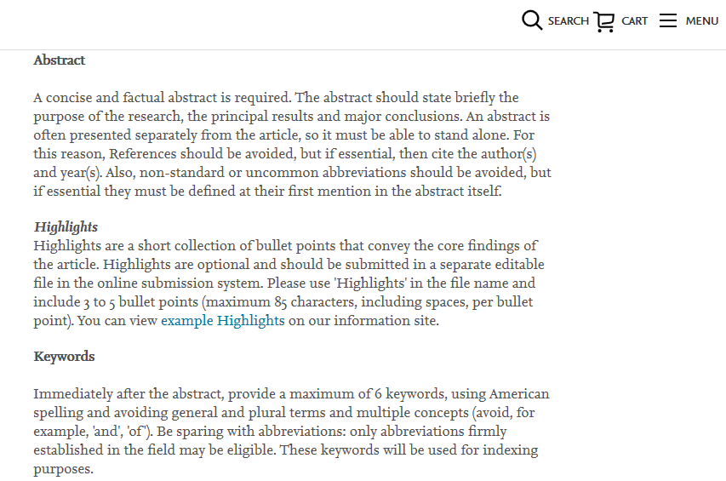
Abstract: Step by step
Check the Guide for Authors:
Example Abstract requirement information in a typical Guide for Authors

Slide 5

Abstract: Step by step continued…
Abstract length

Slide 6

Abstract: Step by step continued…
Purpose / Motivation

Slide 7

Abstract: Step by step continued…
Approach / Methodology

Slide 8

Abstract: Step by step continued…
Findings / Conclusion

Slide 9

And finally…
VALUE

Slide 10
Style
Abstracts are usually written in the active voice, for example:
  Active: Researchers showed previously that smoking can lead to lung cancer.
  Passive: It was previously demonstrated that lung cancer can be caused by smoking.
10-12 Keywords or phrases
Word count
Avoid being general and vague

Slide 11
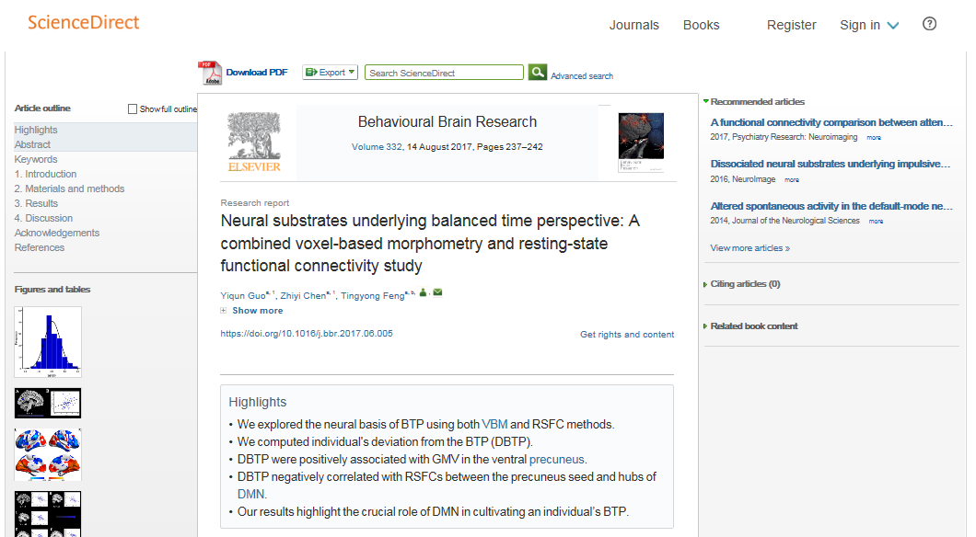
Highlights

Slide 12
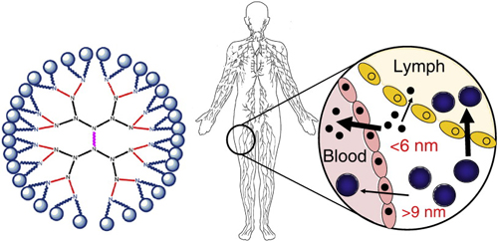
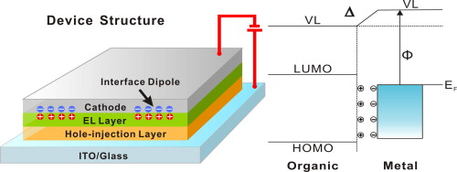
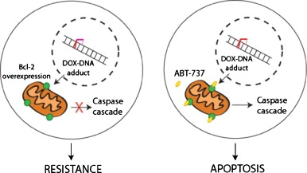
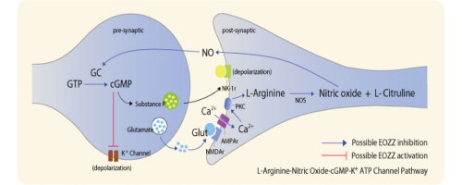
Graphical Abstracts
Source: www.elsevier.com/authors/journal-authors/graphical-abstract

Slide 13

Peer review BEFORE peer review
Proof read and edit yourself
Ask others for help
Consider professional proof reading and editing services if needed
Don’t be afraid of criticism

Slide 14
Recap - How to write a killer abstract
Write your abstract last
Understand the value of a great abstract
Read and adhere to the Guide for Authors
Seek feedback on your written work

Slide 15
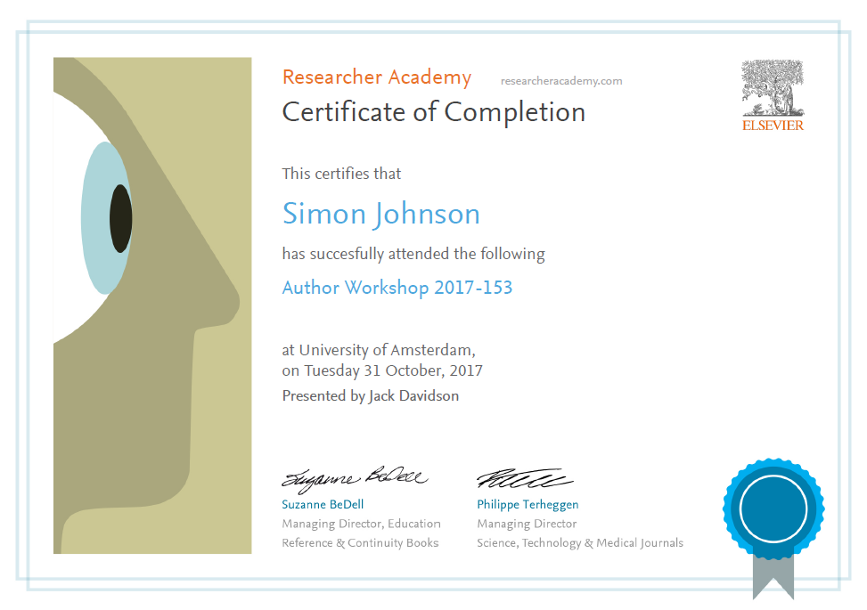
Thank you.
Ask your questions on:
Researcher Academy Mendeley group
Follow us on Twitter

